Slide 1

Car Carbon Footprint Evaluation Tool using Machine Learning
Team Members:
22071A05D2 - Ananya
22071A05E9 - Srujana
22071A05F8 - Akshitha
22071A05G6 - Pranati
Guide: Mrs. Ch. Sandhya Rani
Notes:
1.7.2013
1
‹#›

Slide 2

Agenda
Abstract
Introduction
Literature Review
Existing System and its problems
Proposed System
Problem Statement and objectives
Methodology of the problem
System Requirements
Work Plan
Results
Notes:
1.7.2013
2
‹#›

Slide 3
ABSTRACT
The transportation industry is a major source of carbon emissions, driven largely by fuel consumption and vehicle specifications. This project presents a CO₂ Emission Prediction Tool, a web-based application that leverages machine learning models—including Support Vector Regression, Random Forest, and stacking ensembles—to estimate vehicular carbon emissions based on user inputs such as engine size, fuel type, number of cylinders, etc. The tool supports real-time predictions and offers a scenario comparison feature, allowing users to evaluate the environmental impact of different vehicle configurations. With its intuitive interface and visual outputs, the tool empowers users to make informed decisions for reducing emissions and promoting sustainable transportation.
Notes:
1.7.2013
3
‹#›

Slide 4
INTRODUCTION
This project focuses on delivering accurate and accessible insights into vehicle-related carbon emissions. As climate concerns grow, individuals and policymakers need effective tools to assess and reduce environmental impact. This web-based application uses machine learning models to predict CO₂ emissions based on user-defined vehicle specifications, such as engine size, fuel type, vehicle class, etc. By enabling real-time predictions, scenario comparisons, and visual feedback, the tool empowers users to make data-driven decisions that support sustainable transportation practices.
Notes:
1.7.2013
4
‹#›

Slide 5
LITERATURE REVIEW
S. no. | Reference with DOI | Problem or gap addressed | Objective of the research | Focus of the paper | Inference | Recommendations for future research | How can your research help bridge the gap?
1. | An artificial neural network tool to support the decision making of designers for environmentally conscious product development | Addresses the challenges designers face in integrating sustainability into product development, complexity of balancing environmental impact with cost-effectiveness. | Developing an AI tool to help designers integrate sustainability early in design to assess life cycle impacts on carbon footprint and cost, enhancing efficiency and user-friendliness. | The research uses an ANN for optimizing design parameters, assessing carbon footprint and cost, and improving speed and accuracy over existing life cycle methods. | The study highlights the value of early sustainability integration in design, with the AI tool enabling accurate, efficient, and eco-friendly decision-making. | Expanding the input parameters and integrating other AI techniques. | The tool's ability to identify trade-offs between environmental impact and cost enhances the overall efficiency and effectiveness of designing sustainable products.
Notes:
1.7.2013
5
‹#›

Slide 6
2. | Advanced Predictive Modeling of Pollutant Gas Emissions in the Automotive Industry based on Machine Learning | Critical need for accurate prediction of CO2 emissions in the automotive industry, essential for enhancing fuel efficiency and promoting environmental sustainability, highlights the gap in existing models by employing advanced machine learning techniques to analyze a diverse dataset from 46 automotive brands, thereby improving the robustness and accuracy of emissions forecasting. | The primary objective of the research is to develop an advanced predictive modeling approach using machine learning techniques to accurately estimate CO2 emissions in the automotive industry. | Create a predictive model for estimating CO2 emissions in the automotive industry, highlights the significance of incorporating a diverse set of features from various automotive brands. | The research demonstrates that machine learning can significantly enhance the accuracy of predicting CO2 emissions in the automotive industry, achieving a mean squared error (MSE) of 29.99 and an R^2 of 0.991, indicating a strong correlation between predicted and actual emissions. | Future research should explore the integration of real-time data and advanced machine learning algorithms to enhance the predictive accuracy of CO2 emissions models in the automotive industry, potentially incorporating additional environmental factors and vehicle technologies. | Developing a system that collects real-time data from IoT-enabled automotive sensors and environmental monitoring devices, feeding it into machine learning models designed for continuous learning. Advanced algorithms, such as ensemble learning or neural networks, can be used to analyze the data and dynamically update predictions.
Notes:
1.7.2013
8
‹#›

Slide 7
3. | Machine Learning and Deep Learning Analysis of Vehicle Carbon Footprint | Addresses the problem of vehicle-induced carbon emissions, a major contributor to climate change, by analyzing complex datasets of fuel consumption and CO2 emissions using machine learning and deep learning techniques. It focuses on improving the accuracy and efficiency of prediction in the automotive sector​. | The objective of the research is to analyze vehicle fuel consumption and CO2 emissions using machine learning and deep learning models to predict and manage emission levels accurately. This aims to provide actionable insights for reducing the environmental impact of the automotive sector and promoting sustainable practices. | The study utilized a dataset of vehicle attributes and CO2 emissions, applying data preprocessing techniques like feature selection and cleaning to ensure accuracy. Machine learning and deep learning models, including Random Forest, CNN, and RNN, were trained and evaluated to predict emissions, with Random Forest and CNN showing the best performance​. | The study demonstrates that advanced machine learning and deep learning models, particularly Random Forest and CNN, effectively predict vehicle CO2 emissions, offering valuable insights for reducing emissions and advancing sustainable automotive practices​. | Future research should explore more advanced deep learning models and broader datasets to further improve prediction accuracy and develop practical solutions for emission reduction in the automotive sector​. | Integrate advanced machine learning models like Random Forest or CNN with real-world vehicle data, focusing on emissions prediction and optimization in a scalable application.
Notes:
1.7.2013
9
‹#›

Slide 8
4. | The Calculation of Product Carbon Footprint and Optimization Design | The paper addresses the gap in effectively calculating and optimizing the carbon footprint of products throughout their life cycle, focusing on identifying the stages with the highest emissions and proposing reduction measures. | The objective of the research is to analyze the carbon footprint across different stages of a product's life cycle and to develop an optimization design model for reducing carbon emissions effectively. | Employs a recursive algorithm model to calculate the carbon footprint during the manufacturing stage, breaking down the product into components and parts for detailed analysis. It analyzes carbon emissions across four life cycle stages: manufacturing, transporting, using, and disposal, using specific formulas for each stage | The study concludes that effective carbon footprint reduction can be achieved by identifying and optimizing the stages and components of a product's life cycle that contribute the most to carbon emissions. | Future research should focus on developing more advanced algorithms for real-time carbon footprint assessment and exploring the integration of renewable energy sources in the product life cycle to further minimize emissions. | Implement by designing real-time machine learning models with streaming data capabilities for carbon footprint assessment and incorporating optimization algorithms to simulate renewable energy integration in the product life cycle.
Notes:
1.7.2013
10
‹#›

Slide 9
5. | Estimation of transport CO2 emissions using machine learning algorithm | This study bridges the gap in real-world CO2 emissions data for Long-Distance Diesel Trucks (LDDTs) by utilizing on-road measurements via PEMS to capture dynamic driving conditions and their impact on emissions. | The research aims to analyze CO2 emissions from LDDTs in real-world scenarios, identify critical influencing factors, and develop a predictive emission model using deep learning (LSTM). | The study employed PEMS and GPS to collect real-time emissions and driving data, analyzing variables like speed, VSP, acceleration, and road slope. An LSTM model was trained on this data for CO2 emissions prediction. | The LSTM-based model accurately predicts on-road CO2 emissions, showing significant impacts of speed, acceleration, and road slope, with high R² values (0.986-0.990). | Future research should explore advanced deep learning models and broader datasets for real-time emissions prediction and strategies to reduce emissions. | Integrate LSTM models with real-time PEMS data collection systems to monitor and predict CO2 emissions based on dynamic driving conditions. Develop sequence-based deep learning models like LSTM with temporal data inputs for accurate, real-time prediction of CO2 emissions under varying driving conditions.
Notes:
1.7.2013
11
‹#›

Slide 10
6. | A simplified machine learning product carbon footprint evaluation tool | On the way to climate neutrality manufacturing companies need to assess the Carbon dioxide (CO 2 ) emissions of their products as a basis for emission reduction measures. Product Carbon Footprint (PCF) life cycle analysis as a comprehensive method is applicable, but means great effort and requires interdisciplinary knowledge. | To lower these burdens and provide a digital tool to estimate the PCF with less input parameter and data. | The methodology involves using life cycle analysis (LCA) to assess CO2 emissions and employing machine learning techniques to simplify the evaluation process through the MINDFUL framework, which integrates necessary calculations and CO2 factors for efficient Product Carbon Footprint estimation. | Their contribution presents the requirements of the simplified editorial tool to estimate the PCF with ML. The underlying method is presented as well as the software architecture to provide an easy-to- use software tool. | Building more default training data-sets from a wide range of industrially manufactured goods. The user experience needs to be evaluated to improve the software. More pre-defined emission factors especially for different pre-chains of material need to be integrated. | Large, diverse datasets can be built using data augmentation and transfer learning. User feedback loops and active learning can enhance the tool's usability and integrate more accurate emission factors.
Notes:
1.7.2013
6
‹#›

Slide 11
7. | Machine Learning Algorithm to Predict CO2 Using a Cement Manufacturing Historic Production Variables Dataset | The problem addressed is in the reliance on the IPCC technique for calculating CO2 emissions in the cement industry, which is limited by its complexity, dependence on material measurements, and exclusion of other critical process variables, leading to accuracy concerns and costly, time-intensive audits. | The goal of the paper is to leverage machine learning and AI to estimate CO2 emissions in the cement manufacturing calcination process, identify key manufacturing variables influencing emissions through sensitivity analysis, and develop predictive models to optimize processes and reduce CO2 generation. | The study employs machine learning to predict CO2 emissions in cement manufacturing, using six algorithms trained on over 6000 historical data points, focusing on oxidation and calcination degrees, while evaluating the impact of manufacturing variables through sensitivity analysis and RMSE | The study concludes that machine learning can effectively model CO2 emissions in cement manufacturing by identifying significant process variables, thereby enhancing understanding of the calcination process and its impact on emissions | Further research could explore the integration of real-time data monitoring systems to enhance the predictive accuracy of CO2 emissions models and investigate the application of advanced machine learning techniques, such as deep learning, to improve insights into the calcination process and its variables | Future research can bridge gaps by integrating real-time data monitoring and advanced machine learning techniques to enhance the predictive accuracy of CO2 emissions in cement manufacturing
Notes:
1.7.2013
12
‹#›

Slide 12
8. | Quantifying the Impact of Sustainable Product Design Decisions in the Early Design Phase Through Machine Learning | There are limited methods to quantitatively assess environmental impacts during the early design phase, with current tools like LCA being applicable only later, forcing reliance on experience or empirical knowledge. | To develop a method that quantifies environmental impacts during the early design phase to guide sustainable product design decisions. | A multi-layer perceptron neural network with backpropagation relates LCA impacts of 37 case study products to their attributes, supported by a sustainable design knowledge search tree and a weighting system for design decisions. | By defining the relationship between LCA data and product attributes, designers in the early design phase will be more informed of which product attributes have the largest environmental impact, such that the designer can redesign the product to have reduce this impact. | The influence of logistical factors is excluded from this research and can be explored in further research | Incorporating logistical factors, the ML approach can be extended to include the environmental impact of transportation, storage, and distribution by integrating data on supply chain emissions, packaging, and delivery methods into the neural network's input features.
Notes:
1.7.2013
13
‹#›

Slide 13
9. | Advances in application of machine learning to life cycle assessment | Current LCA methods and tools face several limitations including: (a) site-specific considerations (b) model complexity (c) scenario uncertainty (d) health and wellbeing (e) recycled material data (f) lack of consideration for social and economic aspects | This paper aims to investigate the role of ML methods in LCA across three levels: Buildings, Districts and cities Miscellaneous | A literature review in applying ML in LCA was performed, and 81 relevant studies were analyzed according to the research questions. The methodology was based on five phases: Planning Search Filtering Evaluation Extraction | The reviews show that ML is primarily used in LCA for prediction and data completion at the inventory level and for optimization during model simulation; Developing ML techniques, such as predictive control and optimization algorithms, can help policymakers reduce the gap between predicted and actual environmental impacts by informing control strategies. ML methods can match typical LCA accuracy and predict trends effectively. | Future research should focus on real-time ML applications for monitoring, optimizing, and controlling built-environment systems, leveraging hybrid models and dynamic data to enhance LCA accuracy and environmental impact reduction while addressing cost and complexity challenges. | develop hybrid ML frameworks combining predictive algorithms with advanced stochastic metaheuristics to improve accuracy and reliability in real-time LCA applications.
Notes:
1.7.2013
13
‹#›

Slide 14
10. | Towards Carbon-Free Automotive Futures: Leveraging AI And ML For Sustainable Transformation | The paper addresses the urgent need to reduce carbon emissions in the automotive sector, which contributes a quarter of global CO2 emissions. It highlights slow progress in adopting carbon-free alternatives and the challenges of integrating AI/ML for energy optimization, EV management, and emissions reduction, compounded by regulatory, infrastructure, and ethical barriers. | The research aims to explore AI and ML's potential in making the automotive industry sustainable by reducing emissions, optimizing batteries, managing EV charging, and enabling intelligent traffic systems for zero-carbon solutions. | The research focuses on using AI/ML for a sustainable automotive future, exploring applications like emissions monitoring, EV energy optimization, eco-driving, and traffic control, while addressing regulatory and ethical challenges. | The integration of AI/ML in the automotive industry demonstrates significant promise in reducing carbon emissions and advancing towards a zero-carbon future. However, achieving these goals requires addressing technological, regulatory, and ethical challenges. The adoption of AI/ML solutions is critical to making the transportation sector more sustainable and efficient. | Future research should enhance AI/ML scalability for autonomous and electric vehicles, develop regulatory frameworks, improve battery technologies, and foster collaboration to address infrastructure challenges. | This research bridges the gap by showcasing AI/ML applications to tackle carbon challenges, offering a roadmap for efficiency, emissions reduction, and policy development for carbon-free automotive systems.
Notes:
1.7.2013
13
‹#›

Slide 15
11. | A machine learning algorithm to explore the drivers of carbon emissions in Chinese cities | The research tackles the challenge of reducing carbon emissions in Chinese cities, the world's largest emitters, and highlights the inadequacies of traditional econometric models in analyzing complex, multi-faceted drivers of emissions | The study aims to identify key drivers of carbon emissions in Chinese cities using advanced machine learning algorithms and compare their effectiveness to traditional methods. It examines the impact of economic, external, and policy factors on emissions, with a focus on how these vary by city size, to provide targeted insights for sustainable urban development​ | The focus lies in comparing machine learning models to traditional approaches for predicting carbon emissions, exploring the relationships between economic, policy, and environmental factors, and offering scalable solutions | The study finds energy consumption as the main driver of carbon emissions, with economic policy uncertainty and foreign direct investment (FDI) also playing significant roles. Machine learning models, especially the Extra-trees algorithm, outperform traditional methods in prediction accuracy and interpretability, providing clearer insights through variable importance rankings and partial dependency plots​. | Future research should: Explore enterprise-level data for granular insights. Optimize machine learning models with advanced parameter tuning. Investigate deep learning models for handling larger datasets and complex interactions​ | By integrating machine learning techniques, this research provides a robust framework for analyzing and predicting carbon emissions, aiding policymakers in designing targeted, data-driven interventions to achieve sustainable urban development​.
Notes:
1.7.2013
13
‹#›

Slide 16
12. | Application of various machine learning algorithms in view of predicting the CO2 emissions in the transportation sector | The study highlights a gap in predicting CO2 emissions in Türkiye's transportation sector, where rapid vehicle use and energy consumption growth occurs. It emphasizes the need for advanced machine learning models to improve emission estimates and inform environmental policy. | The primary objective of this research is to use artificial intelligence algorithms—specifically MLP, XGBoost, and SVM—to estimate CO2 emissions in Türkiye's transportation sector. The study evaluates different scenarios to determine which algorithm offers the most accurate predictions and insights into the relationships between key input parameters and CO2 emissions. | This paper employs machine learning to analyze historical data on energy consumption, vehicle kilometers, population, and GDP to forecast CO2 emissions in Türkiye's transportation sector, focusing on a comparative analysis of various models across different scenarios. | The findings reveal strong correlations between CO2 emissions and key factors, with energy consumption having the highest correlation, followed by vehicle kilometers, population size, year progression, and GDP per capita. The XGBoost algorithm outperformed other models in specific scenarios, indicating that advanced modeling can enhance predictive accuracy for environmental impacts. | Future research should explore additional machine learning algorithms, like Random Forest or K-Nearest Neighbors, to improve CO2 emissions predictions. Including variables such as fuel types and traffic patterns could enhance insights, and scenario modeling should consider policy interventions like carbon taxes or electric vehicle incentives. | This research shows that advanced AI techniques can more accurately predict CO2 emissions than traditional linear methods. By rigorously testing multiple algorithms with real-world data from Türkiye's transportation sector, it provides policymakers with actionable insights for effective greenhouse gas reduction strategies.
Notes:
1.7.2013
13
‹#›

Slide 17
13. | Machine-Learning-Based Carbon Dioxide Concentration Prediction for Hybrid Vehicles | The paper addresses the challenge of accurately predicting CO₂ concentrations in hybrid vehicles (HVs) due to the complex, dynamic nature of powertrain transitions, which existing machine learning models struggle to handle effectively. | To develop an efficient, accurate, and lightweight machine learning model (UWS-LSTM) for real-time prediction of CO₂ concentrations in HVs, overcoming the deficiencies of traditional models and making it viable for deployment on IoT devices. | The research focuses on developing the UWS-LSTM model for accurate CO₂ emission prediction in hybrid vehicles, with deployment on low-powered IoT devices for real-time use. It highlights the model's superior accuracy, speed, and practicality, making it suitable for real-world applications. | The UWS-LSTM model achieved a 97.5% accuracy rate, significantly outperforming traditional and advanced ML models. It effectively handled the non-linear CO₂ concentration fluctuations caused by powertrain switchovers in HVs, making it suitable for real-world use. | Focus on reducing the execution time of the UWS-LSTM model for faster real-time applications. Explore broader applications of the model in other types of vehicles and emission scenarios. Investigate further optimization for deployment on diverse IoT platforms. | This research bridges the gap by providing a practical solution for predicting HV CO₂ emissions during dynamic driving scenarios. The deployment of the UWS-LSTM model on IoT devices democratizes access to emissions data, aiding policymakers and manufacturers in reducing vehicular pollution.
Notes:
1.7.2013
13
‹#›

Slide 18
14. | Carbon dioxide emission prediction using support vector machine | The industrial sector significantly contributes to CO₂ emissions due to the extensive use of fossil fuels like coal and electricity. There is a need for accurate models to predict these emissions and aid in monitoring and reducing their environmental impact. Existing methods lack sufficient accuracy and adaptability to dynamic industrial processes. | The study aims to design a Support Vector Machine (SVM)-based model to accurately predict CO₂ emissions by analyzing energy consumption (electricity and coal) in the manufacturing industry. The goal is to provide a low-error, reliable tool for environmental monitoring and decision-making. | The paper focuses on using energy consumption data as inputs to the SVM model, optimizing model parameters (C and Epsilon), and validating the model's prediction accuracy through techniques like Root Mean Square Error (RMSE) and cross-validation. | The SVM model demonstrated high accuracy in predicting CO₂ emissions, with an RMSE of 0.004 using optimal parameters (C=0.1, Epsilon=0). The prediction results closely matched actual emissions data, highlighting the model's reliability and effectiveness. | Future research could use optimization techniques like genetic algorithms for SVM parameter selection, include renewable energy variables, and explore hybrid models for improved accuracy. | This research offers a data-driven approach to accurately predict CO₂ emissions, helping industries monitor and reduce their environmental impact while supporting policy development and sustainable practices.
Notes:
1.7.2013
13
‹#›

Slide 19
15. | Predictive Modeling of Vehicle CO2 Emissions Using Machine Learning Techniques: A Comprehensive Analysis of Automotive Attributes | Concerns about protecting the environment and reducing the negative effects of greenhouse gas emissions, particularly in the automotive industry, have raised interest in finding creative and innovative ways to reduce carbon dioxide (CO 2 ) emissions from a variety of sources. | This study paper delves deeper into the intriguing possibilities of using machine learning (ML) techniques to predict the amount of CO 2 emitted by cars. We are exploring the subject of machine learning to develop a system that can forecast CO 2 emissions based on many parameters. | The paper focuses on the creation of accurate and dependable prediction models capable of estimating CO 2 emissions from cars is the main goal of this research. Environmental policymakers, customers, and manufacturers may all benefit greatly from these models. To do this, we employ a variety of machine learning (ML) techniques, including neural networks, decision trees, and regression algorithms. | Evaluates the prediction accuracy, scenario handling flexibility, and information processing efficiency of several systems through this study. Determines which machine learning models are most suited for predicting CO 2 emissions within the parameters of the given dataset by applying a methodical evaluation approach. | Furthermore, we investigate the influence of different feature subsets on prediction performance, shedding light on the relative importance of various vehicle attributes in determining CO 2 emissions. Our findings not only contribute to advancing the field of predictive emissions modeling but also offer insights into the key factors driving vehicle-related CO 2 emissions. | This research offers a data-driven approach to accurately predict CO₂ emissions, helping industries monitor and reduce their environmental impact while supporting policy development and sustainable practices.
Notes:
1.7.2013
13
‹#›

Slide 20
16. | Carbon emission prediction models: A review | Amidst growing concerns over the greenhouse effect, especially its consequential impacts, establishing effective Carbon Emission Prediction Models (CEPMs) to comprehend and predict CO₂ emission trends is imperative for climate change mitigation. A review of 147 Carbon Emission Prediction Model (CEPM) studies revealed three predominant functions—prediction, optimization, and prediction factor selection. | Prediction factor selection models, employing Grey Relational Analysis (GRA) and Principal Component Analysis (PCA) for statistical and machine learning models, respectively, filtered factors effectively. | The paper discusses on the historical factors influencing carbon emissions and projected future emissions within a country like China. Also studies carbon emissions in China and concluded that technological substitution is critical to reducing emissions to the lower end of the acceptable range. | Furthermore, paper also involves an analysis of reported prediction factor selection models. Engages in a discussion of exploring the specifics of carbon emission models, and study targets, prediction model evaluation methods, considerations of time and spatial scales in various papers, future carbon emission trends in different countries. | In addition, also discusses other indispensable components such as influencing factors, research objectives, model evaluation, spatial and temporal scales, and future trends. | This research offers a data-driven approach to accurately predict CO₂ emissions, helping industries monitor and reduce their environmental impact while supporting policy development and sustainable practices.
Notes:
1.7.2013
13
‹#›

Slide 21
17. | Company performance measurement for automobile companies: A composite indicator from an environmental perspective. | Current research in the field of performance measurement hasn't presented a rigorous composite indicator for quantifying company performance, with environmental indicators for automobile companies. This paper aims to construct this missing composite indicator. | This new approach is developed, including techniques of fuzzy logic, analytic network process, the entropy theory and a geometric mean with unequal weights. | The paper discusses on the historical factors influencing carbon emissions and projected future emissions within a country like China. Also studies carbon emissions in China and concluded that technological substitution is critical to reducing emissions to the lower end of the acceptable range. | Furthermore, paper also involves an analysis of reported prediction factor selection models. Engages in a discussion of exploring the specifics of carbon emission models, and study targets, prediction model evaluation methods, considerations of time and spatial scales in various papers, future carbon emission trends in different countries. | In addition, also discusses other indispensable components such as influencing factors, research objectives, model evaluation, spatial and temporal scales, and future trends. | This research offers a data-driven approach to accurately predict CO₂ emissions, helping industries monitor and reduce their environmental impact while supporting policy development and sustainable practices.
Notes:
1.7.2013
13
‹#›

Slide 22
18. | Quantifying CO2 Emissions in Vehicles Using Machine Learning. | In the context of the need for environmentally friendly transportation, CO2 Emissions need to be reduced significantly to reduce the overall carbon footprint. Cars are a major source of CO2 emission. The machine enables accurate quantification and prediction of patterns in the data. | First, there is the introduction to the dataset and its corresponding attributes, followed by defining the learning parameters and tuning them using hyperparameter optimization to obtain the optimum parameters for multiple regression models. | Further, evaluation of the mean square error, mean absolute percentage error and R2 measure for evaluating models' predictive performance was performed. Finally, an evaluation of the performance and effectiveness of different machine learning models using the quantitative metrics mentioned above along with qualitative analysis from Shapley Additive Explanations and XGBoost Feature Importance analysis was performed. | Furthermore, paper also involves an analysis of reported prediction factor selection models. Engages in a discussion of exploring the specifics of carbon emission models, and study targets, prediction model evaluation methods, considerations of time and spatial scales in various papers, future carbon emission trends in different countries. | In addition, also discusses other indispensable components such as influencing factors, research objectives, model evaluation, spatial and temporal scales, and future trends. | This research offers a data-driven approach to accurately predict CO₂ emissions, helping industries monitor and reduce their environmental impact while supporting policy development and sustainable practices.
Notes:
1.7.2013
13
‹#›

Slide 23
19. | Framework for Evaluating the Carbon Footprint of Academic Machine Learning Endeavor. | Carbon foot printing has gained massive importance in our tryst to move towards sustainability. With machine learning seen as a solution for many real world problems, sustainability in machine learning is important. Hence the motivation to develop this framework which can aid in foot printing current activities irrespective of architecture and platform. | Through various iterations of preliminary analysis and through research, framework has been implemented and successfully tested on multiple architecture models to accurately compute the same. | Further, evaluation of the performance and effectiveness of different machine learning models using the quantitative metrics mentioned above along with qualitative analysis from Shapley Additive Explanations and Feature Importance analysis was performed. | Paper also involves an analysis of reported prediction factor selection models. Engages in a discussion of exploring the specifics of carbon emission models, and study targets, prediction model evaluation methods in various papers, future carbon emission trends in different countries. | In addition, also discusses other indispensable components such as influencing factors, research objectives, model evaluation, spatial and temporal scales, and future trends. | This research offers a data-driven approach to accurately predict CO₂ emissions, helping industries monitor and reduce their environmental impact while supporting policy development and sustainable practices.
Notes:
1.7.2013
13
‹#›

Slide 24
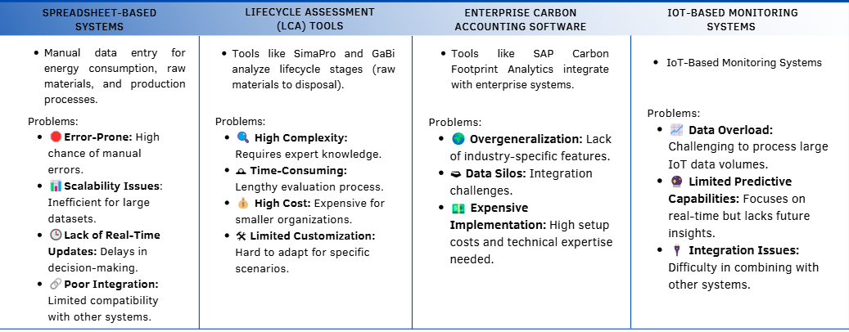
EXISTING SYSTEM AND ITS PROBLEMS
Notes:
1.7.2013
14
‹#›

Slide 25
PROPOSED SYSTEM
We propose a web-based tool using stacked machine learning models to estimate carbon emissions of vehicles.
Base Models: Random Forest and SVR capture non-linearities and specific patterns in the dataset.
Meta Model: Gradient Boosting combines base predictions to provide more accurate emission forecasts.
Users enter inputs such as engine size, fuel type, consumption, and transmission type.
The tool generates carbon emission predictions, supported by scenario comparisons.
Includes a clean dashboard and reporting module for easy interpretation and decision support.
Notes:
1.7.2013
15
‹#›

Slide 26
OBJECTIVES
1. Predict CO₂ Emissions Accurately from Vehicle Specifications
Develop a robust machine learning tool that predicts carbon emissions based on key vehicle features like engine size, fuel consumption, fuel type, and transmission.
2. Implement Stacked Machine Learning Architecture
Use Random Forest and Support Vector Regression (SVR) as base models and Gradient Boosting as the meta-learner for improved accuracy and generalization.
3. Enable Scenario-Based Comparisons
Allow users to test and compare the carbon impact of different configurations (e.g., fuel types, hybrid vs. non-hybrid) to support informed environmental decision-making.
4. Design for Offline and Local Use
Build a lightweight system that can function without cloud access, making it suitable for use in institutions, rural areas, or privacy-sensitive environments.
5. Deliver a User-Friendly, Interactive Web Application
Create a web interface using React.js for intuitive user interaction, coupled with data visualizations (using Chart.js or Plotly.js) to explain emission outcomes clearly.
6. Promote Sustainable Choices
Support policymakers, manufacturers, and individuals by providing actionable insights into reducing carbon emissions through smart vehicle design and usage choices.
Notes:
1.7.2013
15
‹#›

Slide 27
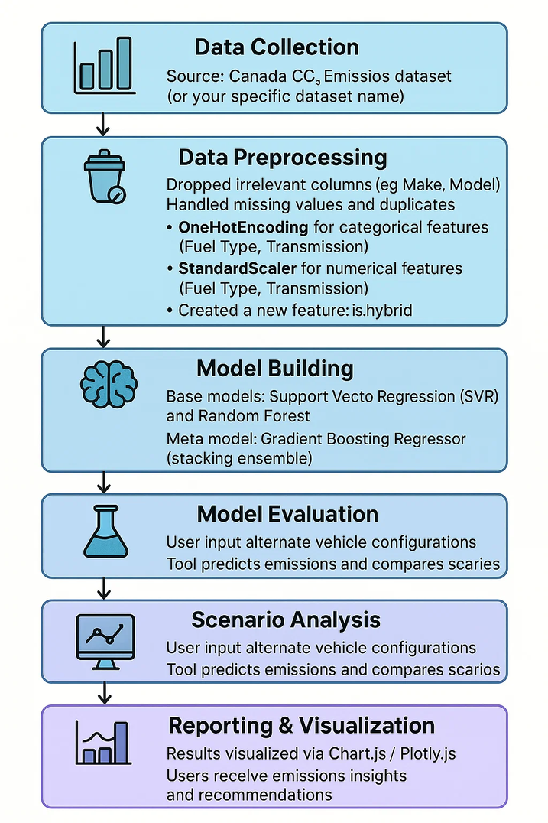
METHODOLOGY
Notes:
1.7.2013
15
‹#›

Slide 28
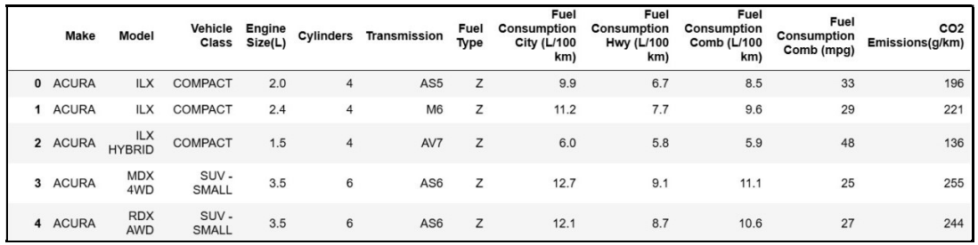
DATASET DESCRIPTION
The dataset used in this project is derived from the Canadian Vehicle Fuel Consumption (from Kaggle)Dataset, which provides comprehensive specifications for a wide range of vehicles.
✅ Key Features (Input Variables):
Features (Inputs):
Engine Size (L)
Number of Cylinders
Fuel Consumption (City & Highway)
Transmission Type
Fuel Type
Hybrid Status
🎯 Target Variable (Output):
CO₂ Emissions (g/km) – The amount of carbon dioxide emitted per kilometer, which is the value predicted by the machine learning model.
Notes:
1.7.2013
15
‹#›

Slide 29
MODULES
1. Data Preprocessing Module
This module prepares the input data to ensure compatibility and optimal performance for the machine learning models. It includes:
Data Cleaning: Drops irrelevant columns such as 'Fuel Consumption Combined', ‘Make’, and ‘Model’, ensuring no duplicate or null entries are used.
Data Transformation: Encodes categorical variables like 'Transmission', 'Fuel Type', and 'Vehicle Class' using OneHotEncoder, while numerical features are scaled using StandardScaler.
Feature Engineering: Selects key input features—such as engine size, cylinder count, vehicle class, and fuel type—that are most influential in predicting CO₂ emissions, as well as creating a new feature called ‘is_hybrid’ to use for prediction.
Purpose: To create a structured, clean, and high-quality dataset for accurate predictions.
Notes:
1.7.2013
15
‹#›

Slide 30
MODULES
2. Model Building and Training Module
This module is responsible for developing and training machine learning models to predict the carbon footprint. It includes:
Algorithm Implementation: Leveraging SVR for precise linear relationships with small-margins and Random Forest for robust decision-tree-based non - linear relationships. A Stacking Regressor combines both through gradient boosting for improved generalization.
Model Training: Using CO2 Emissions Canada dataset to train the model and optimize its parameters.
Hyperparameter Tuning: Adjusting parameters like kernel types (for SVR) and tree depth/number (for Random Forest) to optimize performance.
Performance Evaluation: Assesses models using the R² score, RMSE and visual comparison plots (actual vs predicted values) to identify the most accurate and stable approach.
Purpose: To build a reliable model capable of analyzing various factors affecting carbon footprint.
Notes:
1.7.2013
15
‹#›

Slide 31
MODULES
3. Carbon Footprint Prediction and Scenario Analysis Module
This module focuses on predicting the carbon footprint and analyzing scenarios based on user inputs. It includes:
Prediction: Estimating carbon emissions based on data such as vehicle class, fuel type, number of cylinders, engine size, etc.
Scenario Comparison: Allowing users to input different scenarios and compare carbon emissions for each.
Purpose: To enable users to make data-driven decisions and optimize processes for sustainability.
Notes:
1.7.2013
15
‹#›

Slide 32
MODULES
4. Visualisation Module
This module generates visualisations based on the analysis. It includes:
Visualization: Presenting results through graphs, charts, and dashboards for easy interpretation.
Purpose: To communicate findings effectively and support informed decision-making.
Notes:
1.7.2013
15
‹#›

Slide 33
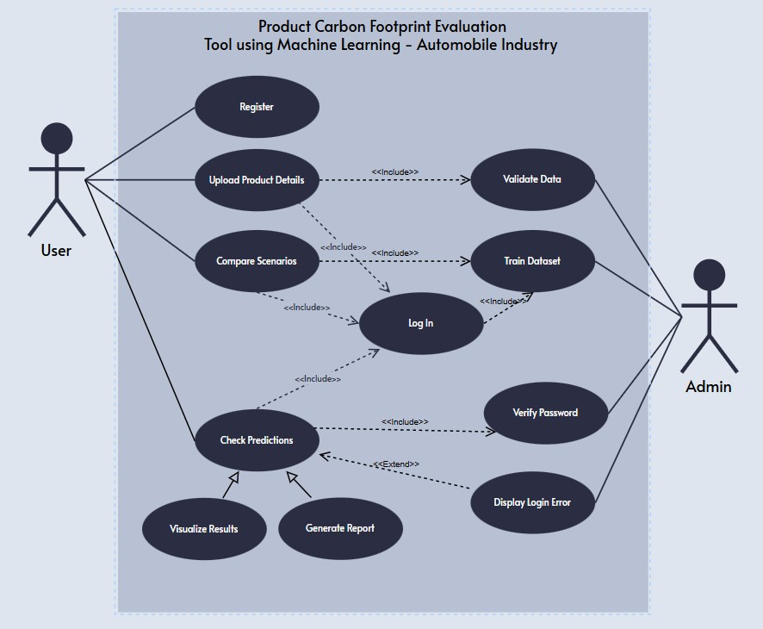
UML DIAGRAMS
USE CASE DIAGRAM:
Notes:
1.7.2013
15
‹#›

Slide 34
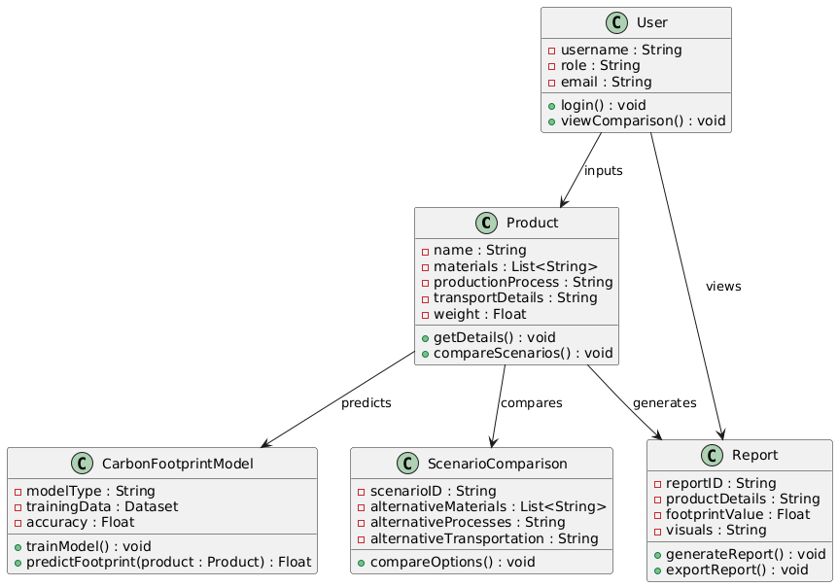
UML DIAGRAMS
CLASS DIAGRAM:
Notes:
1.7.2013
15
‹#›

Slide 35
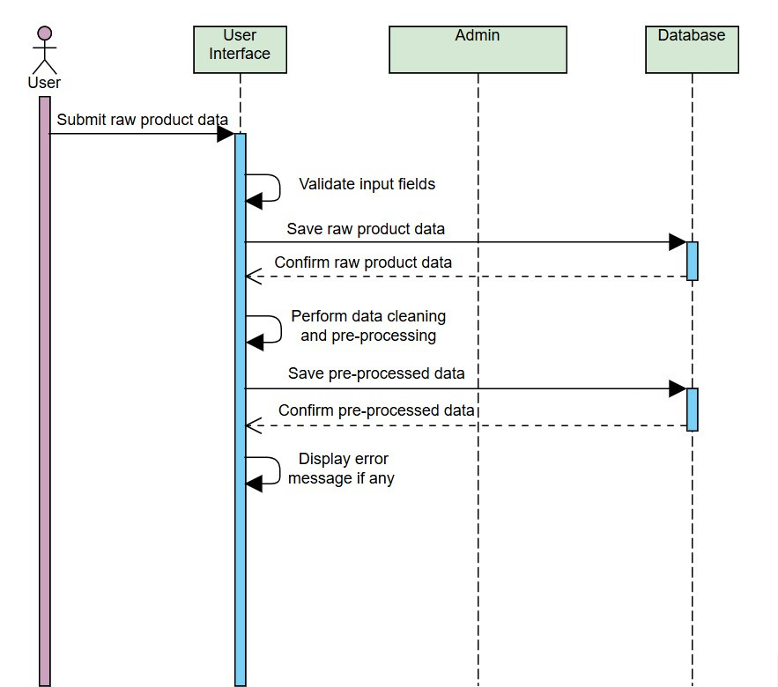
UML DIAGRAMS
SEQUENCE DIAGRAM:
Notes:
1.7.2013
15
‹#›

Slide 36
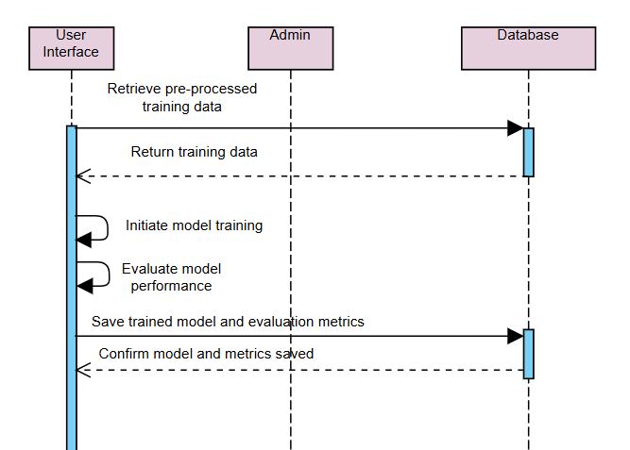
UML DIAGRAMS
SEQUENCE DIAGRAM:
Notes:
1.7.2013
15
‹#›

Slide 37
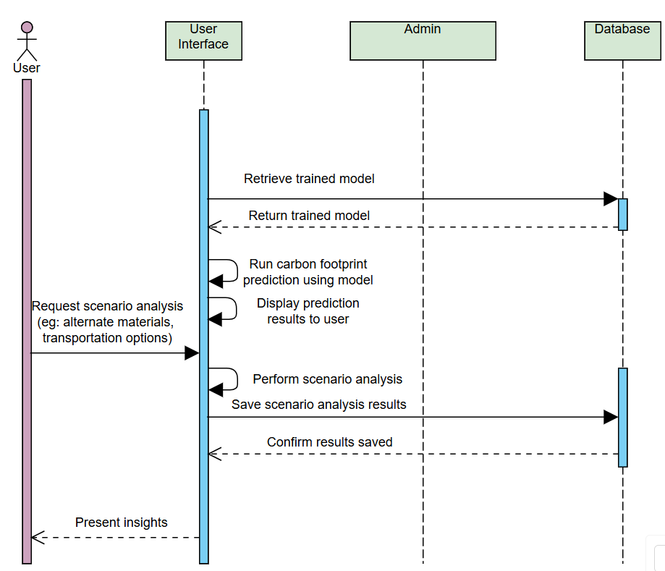
UML DIAGRAMS
SEQUENCE DIAGRAM:
Notes:
1.7.2013
15
‹#›

Slide 38
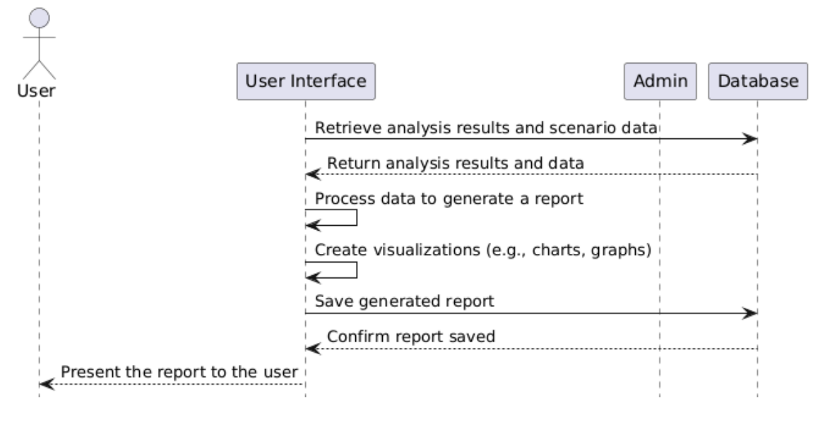
UML DIAGRAMS
SEQUENCE DIAGRAM:
Notes:
1.7.2013
15
‹#›

Slide 39
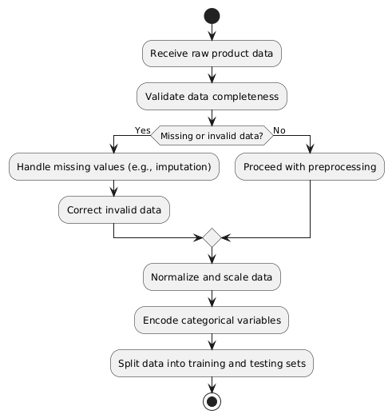
UML DIAGRAMS
ACTIVITY DIAGRAM:
Notes:
1.7.2013
15
‹#›

Slide 40
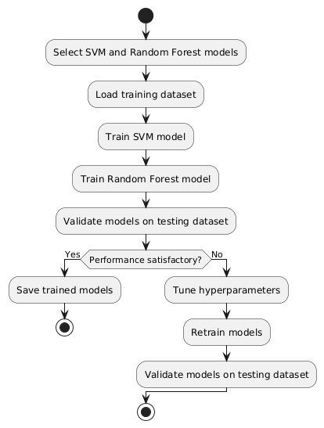
UML DIAGRAMS
ACTIVITY DIAGRAM:
Notes:
1.7.2013
15
‹#›

Slide 41
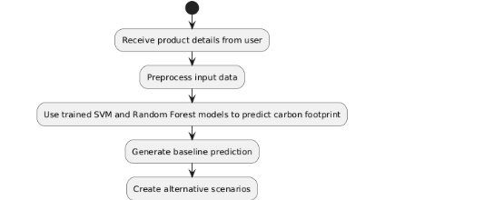
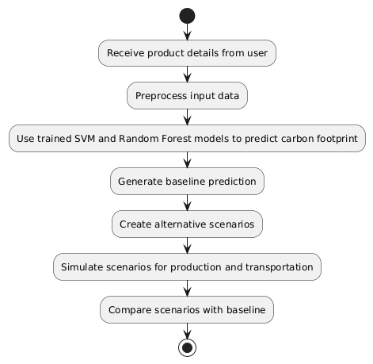
UML DIAGRAMS
ACTIVITY DIAGRAM:
Notes:
1.7.2013
15
‹#›

Slide 42
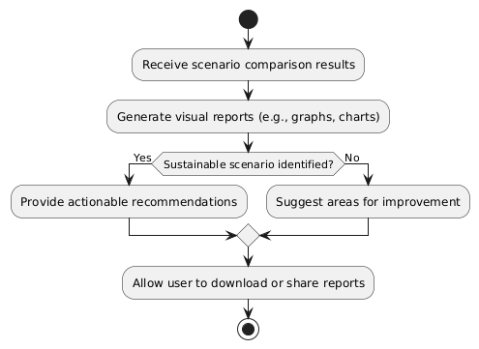
UML DIAGRAMS
ACTIVITY DIAGRAM:
Notes:
1.7.2013
15
‹#›

Slide 43

SYSTEM REQUIREMENTS
Software Requirements
Hardware Requirements
💻 Server-Side Requirements:
Processor: Quad-core, 3.0 GHz or higher
RAM: 16 GB or more
Storage: 500 GB SSD for fast read/write and data storage
Network: High-speed internet connection (1 Gbps) to support simultaneous user access
💻 Client-Side Requirements:
Browser: Latest versions of Chrome, Firefox, or Microsoft Edge
Device: Desktop or laptop with at least 4 GB RAM and a modern multi-core CPU
💻 Software Stack:
Frontend: React.js, Chart.js (or Plotly.js for dynamic graphing)
Backend: Node.js (Express.js)
Machine Learning: Python (Scikit-learn for RF, SVR, Gradient Boosting; Pandas for preprocessing)
Database: MongoDB (storing user data, predictions, and scenario records)
Middleware Axios for API calls
Deployment: GitHub for version control and deployment
Notes:
1.7.2013
16
‹#›

Slide 44
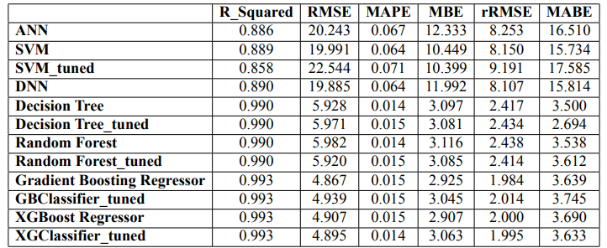
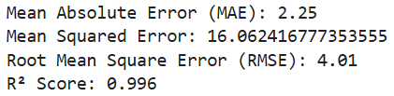
RESULTS
R² Scores of Existing Models
Proposed Model Evaluation
Notes:
1.7.2013
15
‹#›

Slide 45
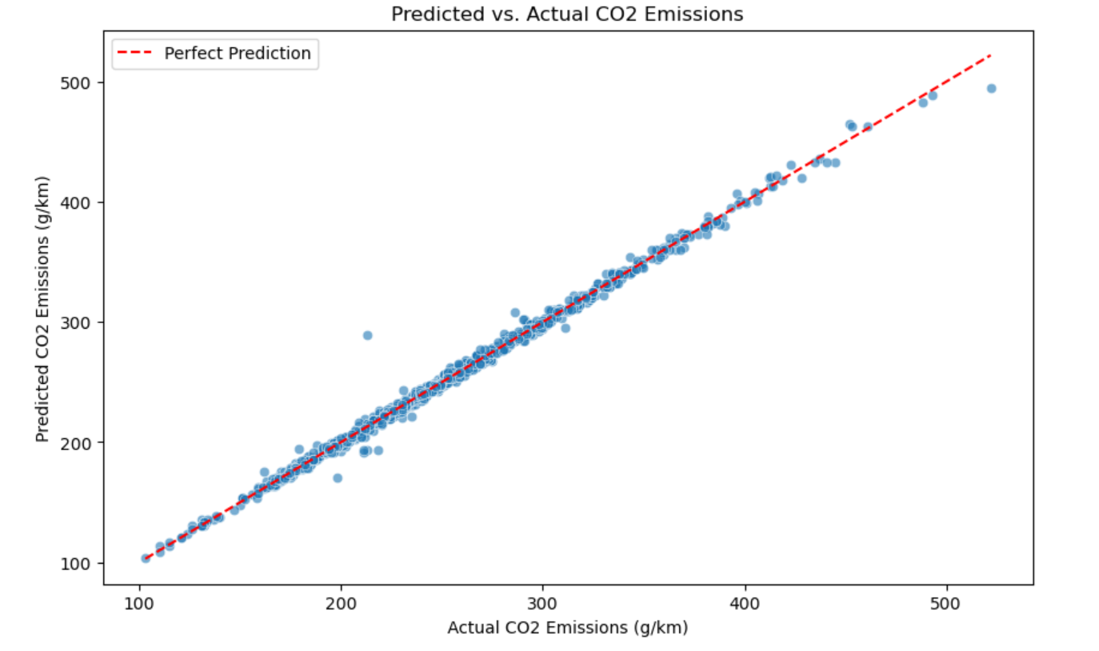
RESULTS
Actual vs Predicted CO₂ Emissions
Notes:
1.7.2013
15
‹#›

Slide 46
CONCLUSIONS
Our project, Product Carbon Footprint Evaluation Tool using Machine Learning, presents a practical and scalable solution for predicting Car CO₂ emissions. By leveraging a stacked ensemble model combining Support Vector Regression and Random Forest, we achieved high prediction accuracy with an R² score of 0.94.
The tool enables:
Scenario-based comparisons for different vehicle configurations
A user-friendly web interface that works offline
This empowers users—be it individuals, researchers, or policymakers—to make data-driven, environmentally conscious decisions. In the long term, tools like this can significantly contribute to sustainable transportation practices and help reduce carbon footprints at both micro and macro levels.
Notes:
1.7.2013
15
‹#›

Slide 47

THANK YOU
Notes:
1.7.2013
17
‹#›

